Slide 1
Introduction to Draw.io

Slide 2
*Draw.io is a free, online diagramming tool that allows you to create flowcharts, diagrams, mind maps, organisation charts, and much more. *A web-based application, Draw.io is fully integrated with Google Drive.

Slide 3
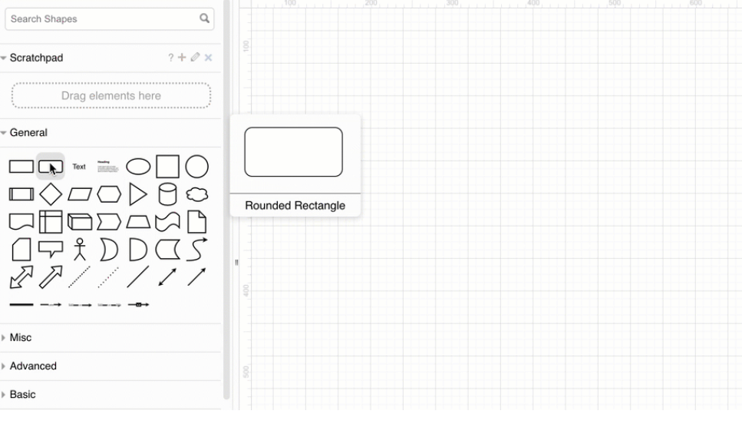
Add shapes to the drawing canvas
Add the first step - Use one of the following methods to add a rectangle to the drawing canvas. Rectangles represent the steps in your process

Slide 4
*Click on a rectangle in the General shape library to add it the drawing canvas.
*Double-click on an empty area on the drawing canvas and select a rectangle shape.
*Drag a rectangle from the General shape library to a specific position on the drawing canvas.

Slide 5
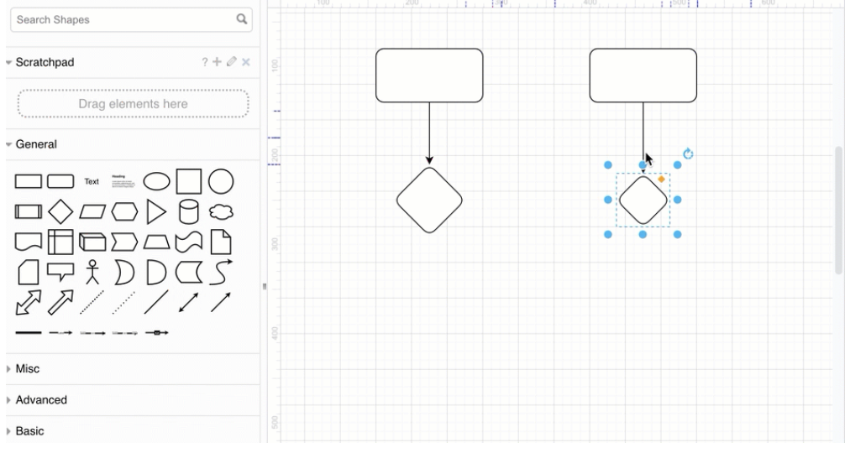
Add more shapes
Hover over the first shape you placed to see the four direction arrows. Click on one of the shapes, then select a shape to add and connect it in that direction.

Slide 6
Shapes for flow charts
Rectangle - Basic steps in your process.
Diamond (rhombus) - Decisions, usually yes/no questions, that split the process into two or more branches.
Circle or oval - Optional start and stop points in your process.
Parallelogram - Input or output, where your process needs or gives information to an external party or system.

Slide 7
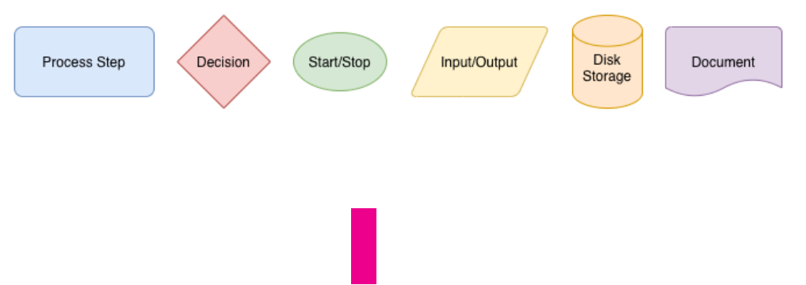
Cylinder - Disk drives, used to indicate that data is stored during that step in the process.
Rectangle with a wavy bottom line - Documents that are produced as a result of a process step.

Slide 8
Move, resize, rotate, and delete shapes
Move - Select and drag a shape that is on the drawing canvas to another position.
Resize - Select a shape. Drag any of the round ‘grab’ handles to make the shape smaller or larger. Hold down Control when you resize shapes to keep them centred.

Slide 9
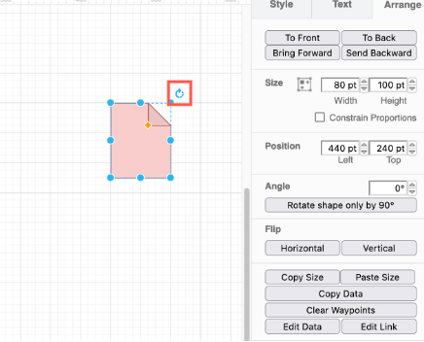
Rotate - Select a shape. Drag the rotate grab handle (the round arrow) at the top right corner of the shape to rotate the shape around its center point.

Slide 10
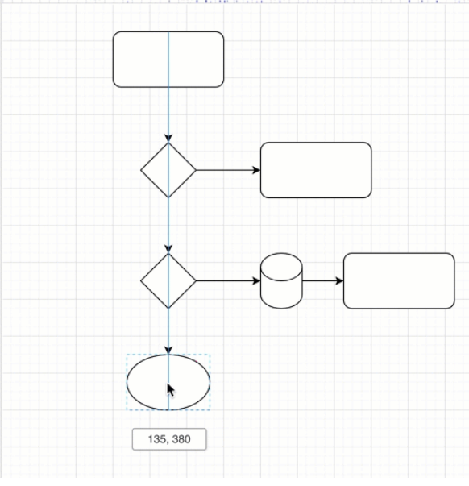
Delete - Select a shape, then press Backspace or Delete, or click on the Delete tool in the toolbar.

Slide 11
Connect shapes
Floating connectors - These move around the perimeter of your shape as you move it around the drawing canvas, or change the route that the connector takes.
Fixed connectors - These stay attached to a fixed point on your shape, even when you move the shape around the drawing canvas.

Slide 12
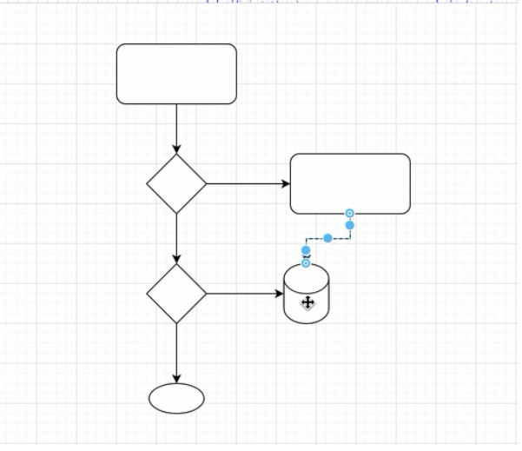
Draw a floating connector
*Hover over the source shape until you see the light direction arrows appear.
*Move your mouse cursor over the direction arrow you want to draw the connector from, then drag the connector out from the arrow towards the target shape.
*Hover over the target shape and release when the outline of the shape is blue.

Slide 13
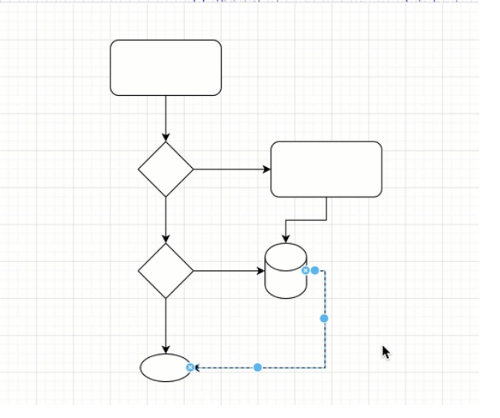
Draw a fixed connector
*Hover over the source shape until you see the little crosses, connection points, around the shape perimeter.
*Drag a connector from the connection point on the source shape towards the target shape.
*Hover over the target shape until you see the connection points, then hover over one of the connection points until it is highlighted in green, and release to attach the connector.

Slide 14
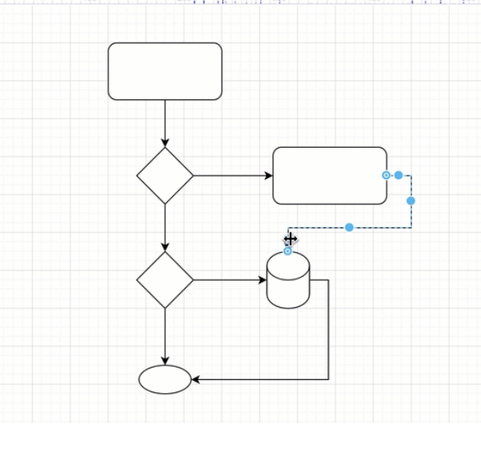
Change the path of a connector
*Select the connector that you want to change the path of to see its waypoints.
*Drag one of the waypoints into a new position. New waypoints will be added automatically based on where you grabbed the connector and where you move your mouse too.

Slide 15
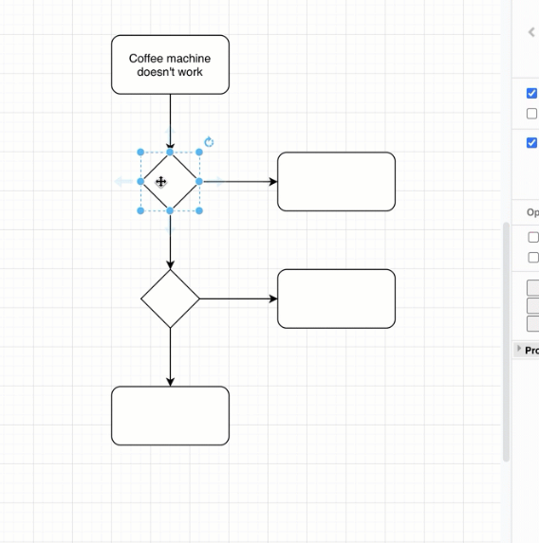
Add labels
*Double click on a shape. Start typing to replace the label with your own text. Alternatively, single click on a shape and start typing to add or edit the label.
*Press Enter to save the label text.

Slide 16
Connector labels You can add more than one label to a connector - at the source end, the target end, and in the middle.
*Double click in the position you want to add a text label there.
*To reposition the connector label text, click on the label, then drag the small yellow diamond to a new position.

Slide 17
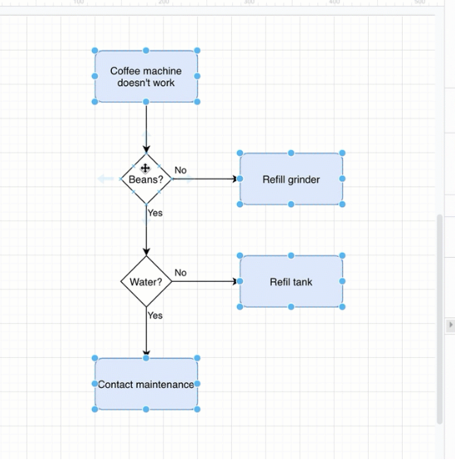
Style your flow chart
Select a shape, or hold Shift down and click on multiple shapes and connectors to select many.

Slide 18
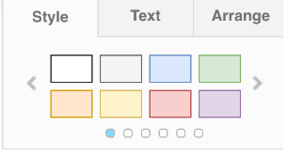
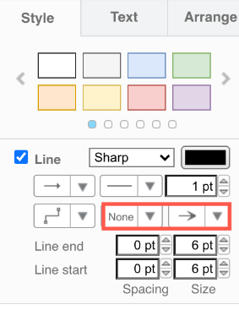
Add colours and style your shapes and connectors via the Style tab.The style palette at the top of the Style tab changes both the fill and outline colour. Click the left or right arrows to view more styles.
Style a selected connector to have arrows on both ends or no arrows.

Slide 19
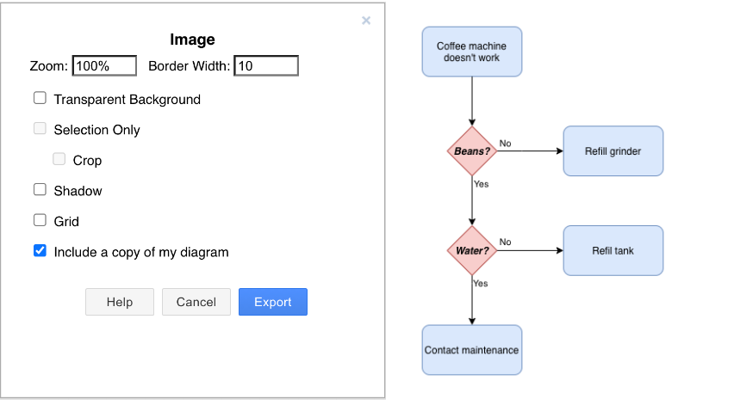
Export and share your flow chart
Export as a PNG, JPEG or SVG to convert your diagram to an image that you can paste into a website or email.

Slide 20
TASK:
- create a flowchart by using draw.io tool of flex attendance feature.
-create a flowchart of how to upload a file in google drive.

